Slide 1
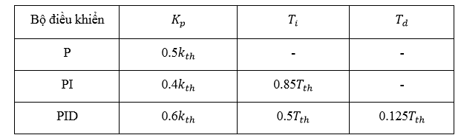
Ziggler-Nichol 2 method
Applied to calculate Kp,Ki,Kd

Slide 2
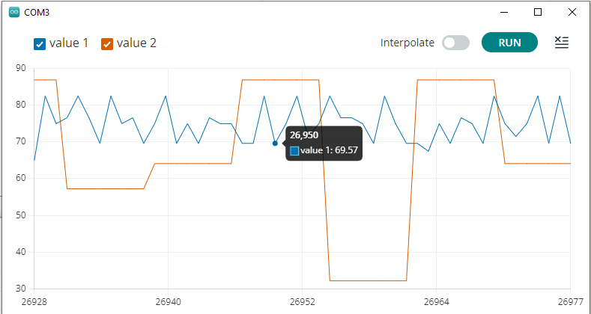
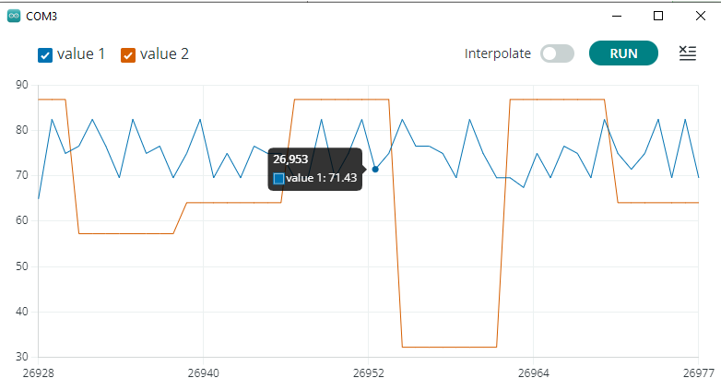
Ziggler-Nichol 2 method
Động cơ 1 :
Kp = 2.4
T = 3ms

Slide 3
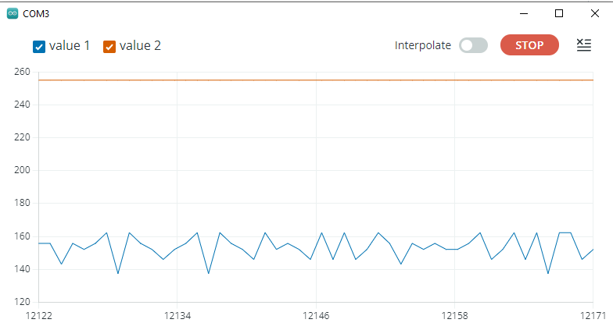
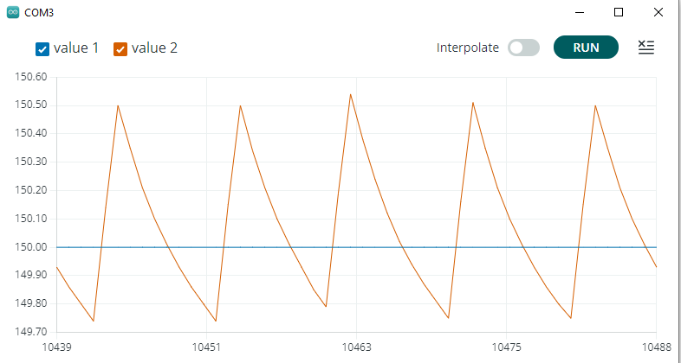
Ziggler-Nichol 2 method
Setpoint = 150
Setpoint = 150
Low-pass Filter
Động cơ 1 :
Kp = 2.4
T = 3ms

